Slide 1

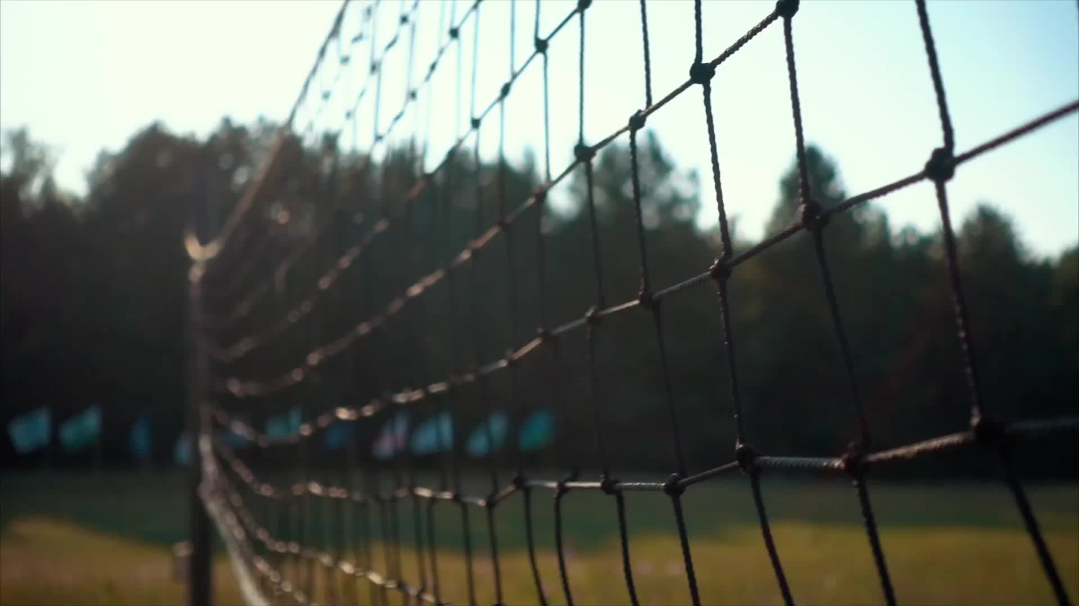


Sports Activities Survey
21L-6292
21L-5659
21L-6234

Slide 2

Importance of Sports
z

Slide 3
Purpose
Understanding Student Engagement
Identifying Interests
Assessing Facilities and Resources
Identifying Barriers
Community Outreach

Slide 4
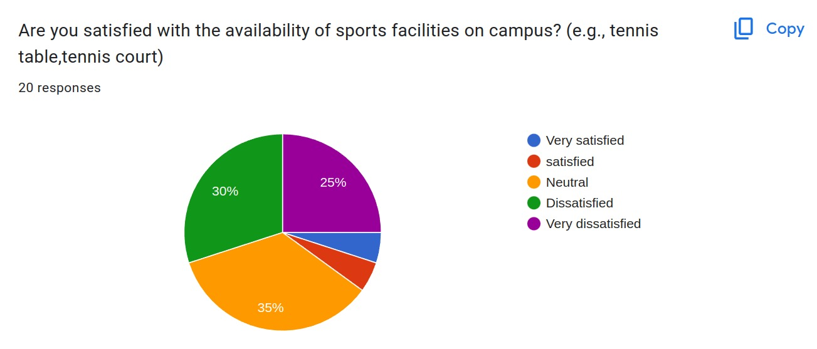
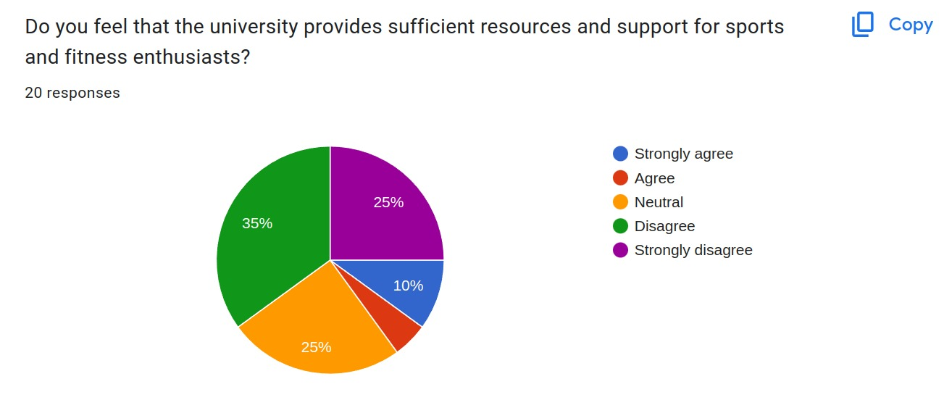
Analysis
Availability of Sports Facilities on Campus
Sufficient resources and support for sports

Slide 5
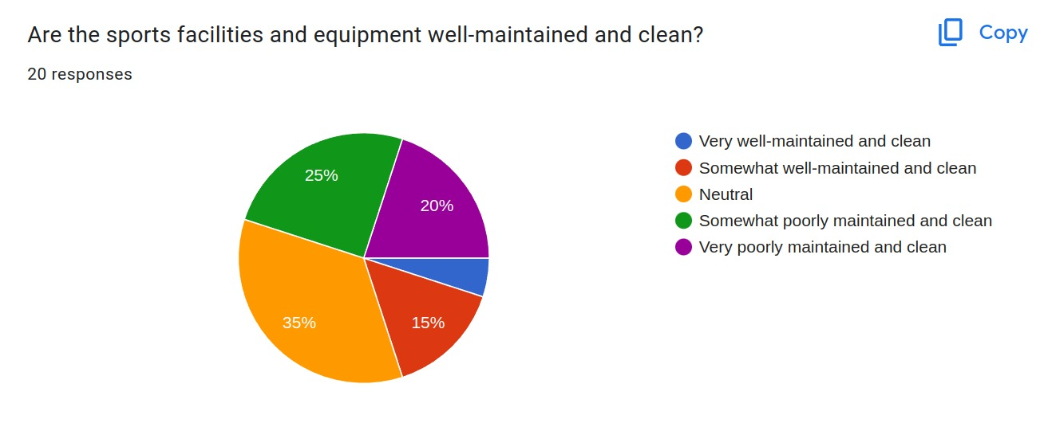

Slide 6
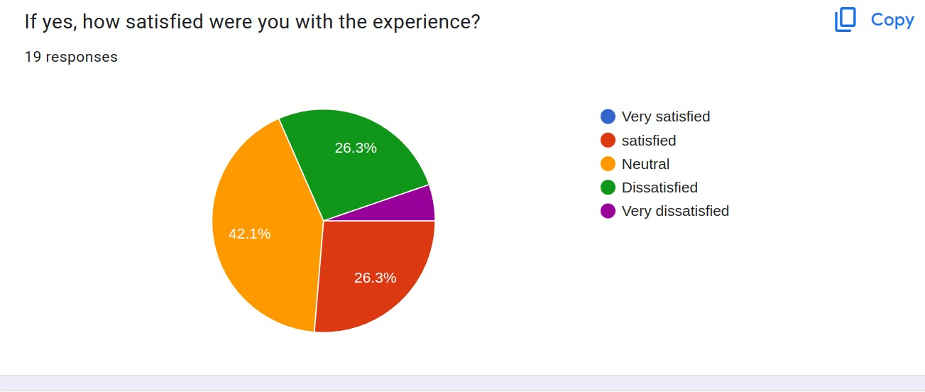
Satisfaction Ratio

Slide 7
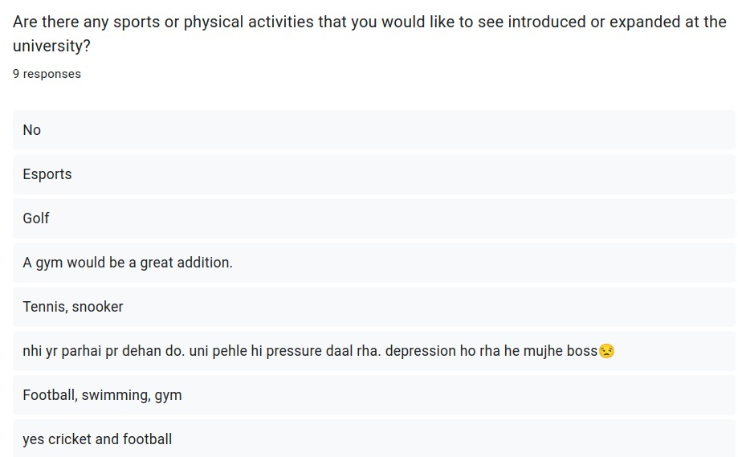

Slide 8
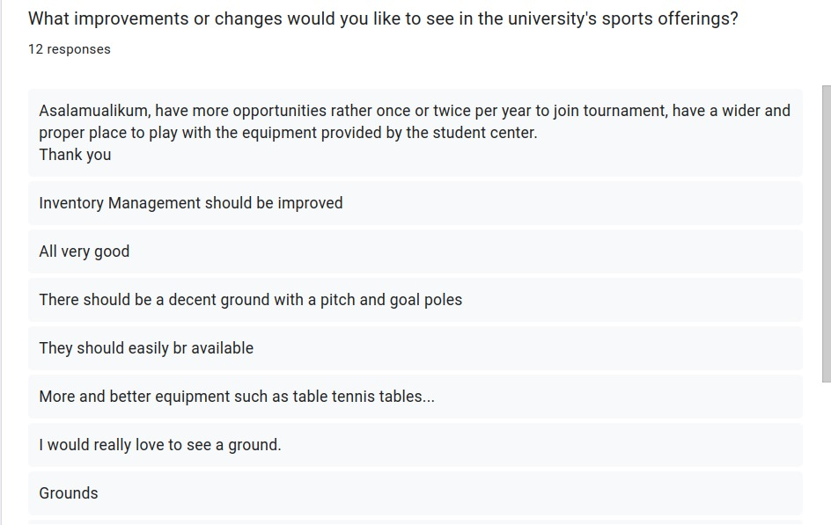

Slide 9

Recommendations
Improve Accessibility
Flexible Scheduling
Diversify Sports Offerings
Support for Competitive Teams
Alumni Involvement
Scholarship Opportunities

Slide 10


Slide 11
Conclusion
z

Slide 12

Any Questions?
z

